Slide 1
Nourriture - Connect People with Ingredients
fastDev@Google Services

Slide 2
Agenda
Overview
Access Google services via Google Play services
Access Google services over HTTP
Example of Google Drive accessing

Slide 3
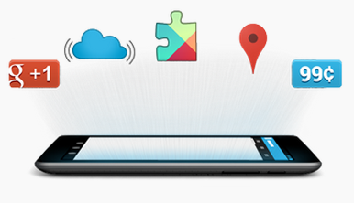
Google Services
Google offers a variety of services that help you build new revenue streams, manage app distribution, track app usage, and enhance your app with features such as maps, sign-in, and cloud messaging.

Slide 4
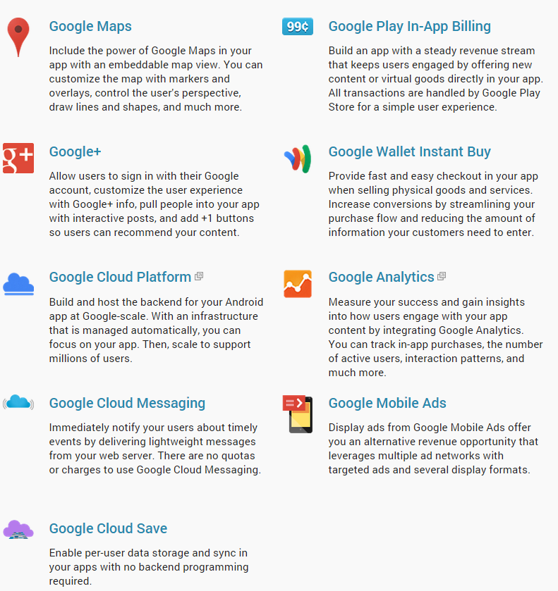
Features List (in Google Play services SDK)

Slide 5
Agenda
Overview
Access Google services via Google Play services
Access Google services over HTTP
Example of Google Drive accessing

Slide 6
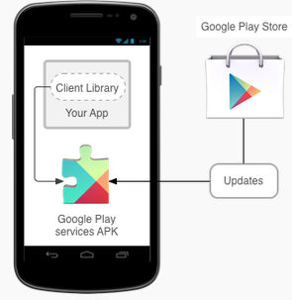
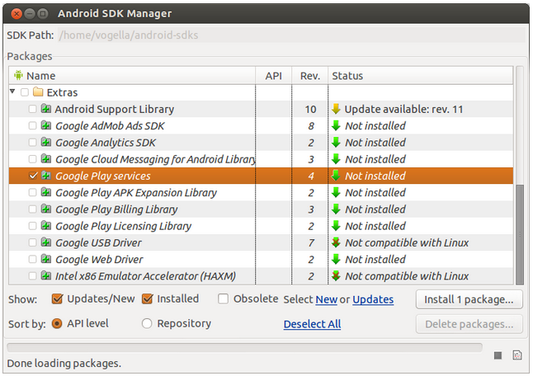
Overview
With Google Play services, your app can take advantage of the latest, Google-powered features such as Maps, Google+, and more, with automatic platform updates distributed as an APK through the Google Play store.
SDK
Service App

Slide 7
Add Google Play Services to Android Project
Copy the library project to the same location of Android app project
<android-sdk>/extras/google/google_play_services/libproject/google-play-services_lib/
Import it into Eclipse workspace, and mark it as a library project
In Android app project, set reference Google Play services library project
Add the following tag as a child of the <application> element in manifest
<meta-data android:name="com.google.android.gms.version“ android:value="@integer/google_play_services_version" />
Refer to http://developer.android.com/tools/projects/projects-eclipse.html#ReferencingLibraryProject

Slide 8
Check the availability of Google Play service
GooglePlayServicesUtil .isGooglePlayServicesAvailable()
Verify the Google Play services availability, and return result as below:
SUCCESS, SERVICE_MISSING, SERVICE_VERSION_UPDATE_REQUIRED,
SERVICE_DISABLED, SERVICE_INVALID, DATE_INVALID
GooglePlayServicesUtil .getErrorDialog()
The returned dialog displays a localized message about the error and upon user confirmation (by tapping on dialog) will direct them to the Play Store if Google Play services is out of date or missing, or to system settings if Google Play services is disabled on the device.

Slide 9
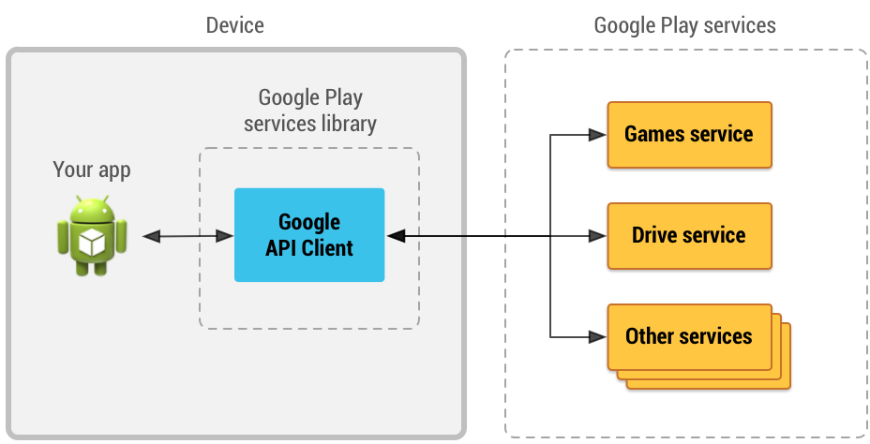
Accessing Google APIs
GoogleApiClient.Builder: Create an instance
GoogleApiClient.ConnectionCallbacks: CB of connection/disconnction
GoogleApiClient.OnConnectionFailedListener: CB of connection failure

Slide 10
Build an instance of GoogleApiClient
protected void onCreate(Bundle savedInstanceState) {
mGoogleApiClient = new GoogleApiClient.Builder(this) .addApi(Drive.API) .addScope(Drive.SCOPE_FILE) .addConnectionCallbacks(this) .addOnConnectionFailedListener(this) .build();
}
protected void onStart() {
mGoogleApiClient.connect();
}
protected void onStop() {
mGoogleApiClient.disconnect();
}
public void onConnected(Bundle connectionHint) {
// Google Play services is connected
}
public void onConnectionSuspended(int cause) {
// Connection has been interrupted, so disable any UI components that depend on API
}
public void onConnectionFailed(ConnectionResult result) {
// handling errors that may occur while attempting to connect with Google
}

Slide 11
Handle the connection failure
// Track if the app is resolving the error so as to avoid repetitive actions for it
private boolean mResolvingError = false;
@Override
public void onConnectionFailed(ConnectionResult result) {
if (mResolvingError) {
// Already attempting to resolve an error. return; } else if (result.hasResolution()) { try { mResolvingError = true;
//same as startActivityForResult() which will trigger onActivityResult onwards
result.startResolutionForResult(this, REQUEST_RESOLVE_ERROR); } catch (SendIntentException e) { // There was an error with the resolution intent. Try again. mGoogleApiClient.connect(); }
} else { // Show dialog using GooglePlayServicesUtil.getErrorDialog() showErrorDialog(result.getErrorCode()); mResolvingError = true; }
}

Slide 12
GooglePlayServicesUtil .getErrorDialog()
private void showErrorDialog(int errorCode) {
// Create a fragment for the error dialog ErrorDialogFragment dialogFragment = new ErrorDialogFragment(); // Pass the error that should be displayed Bundle args = new Bundle(); args.putInt(DIALOG_ERROR, errorCode); dialogFragment.setArguments(args); dialogFragment.show(getSupportFragmentManager(), "errordialog");
}
public void onDialogDismissed() {
mResolvingError = false;
}
public static class ErrorDialogFragment extends DialogFragment {
public ErrorDialogFragment() { } public Dialog onCreateDialog(Bundle savedInstanceState) { // Get the error code and retrieve the appropriate dialog int errorCode = this.getArguments().getInt(DIALOG_ERROR); return GooglePlayServicesUtil.getErrorDialog(errorCode, this.getActivity(), REQUEST_RESOLVE_ERROR);
}
public void onDismiss(DialogInterface dialog) {
((MainActivity)getActivity()).onDialogDismissed(); }
}

Slide 13
Talk to Google Play services @ Async
//example for Google Drive accessing
private void loadFile(String filename) {
// Create a query for a specific filename in Drive. Query query = new Query.Builder() .addFilter(Filters.eq(SearchableField.TITLE, filename)) .build();
// Invoke the query asynchronously with a callback method Drive.DriveApi.query(mGoogleApiClient, query) .setResultCallback(new ResultCallback<DriveApi.MetadataBufferResult>() { @Override
public void onResult(DriveApi.MetadataBufferResult result) {
// Success! Handle the query result. ...
} });
}

Slide 14
Talk to Google Play services @ Sync
//example for Google Drive accessing
private void loadFile(String filename) {
new GetFileTask().execute(filename);
}
//manage the work in worker thread
private class GetFileTask extends AsyncTask<String, Void, Void> {
protected void doInBackground(String filename) {
Query query = new Query.Builder()
.addFilter(Filters.eq(SearchableField.TITLE, filename))
.build();
// Invoke the query synchronously
DriveApi.MetadataBufferResult result =
Drive.DriveApi.query(mGoogleApiClient, query).await(); //blocks until the task is completed.
// Continue doing other stuff synchronously ...
}
}

Slide 15
Agenda
Overview
Access Google services via Google Play services
Access Google services over HTTP
Example of Google Drive accessing

Slide 16
What OAuth
OAuth is an open standard to authorization.
It provides client app a 'secure delegated access' to server resources on behalf of a resource owner without sharing server’s credentials.
OAuth 2.0 is the next evolution of the OAuth protocol and is not backwards compatible with OAuth 1.0. http://oauth.net/2/

Slide 17
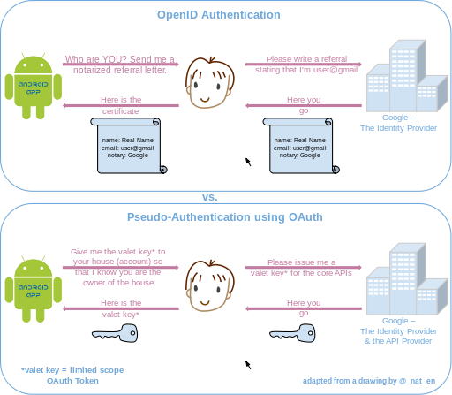
OAuth vs. OpenID
OpenID: App asks the user for their identity (basically a log-in request by app, to which the user typically provides an OpenID URI rather than actual credentials)
App allows the user access, because it trusts the OpenID Identity provider
the API provider allows the app access because it trusts its own valet keys (token)
Oauth: App requests a limited access (Scope) OAuth Token to access the APIs (services) on the user's behalf (which typically names/scopes of services , and does not require the user to enter credentials at all)

Slide 18
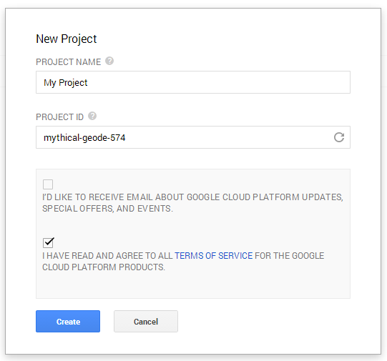
Register app@ Create Project
Google Cloud Console: https://console.developers.google.com

Slide 19
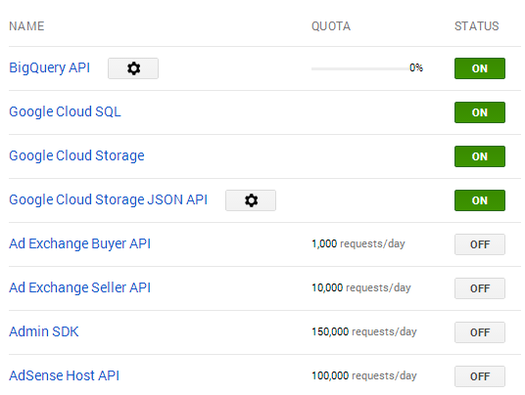
Register app@ Enable/Disable APIs

Slide 20
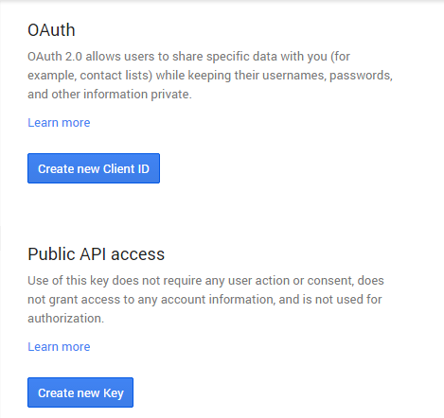
Register app@ Create Credential
For authorization, for app to submit authorized requests
Not for authorization, for app to make API calls
Notes:
Consent:同意

Slide 21
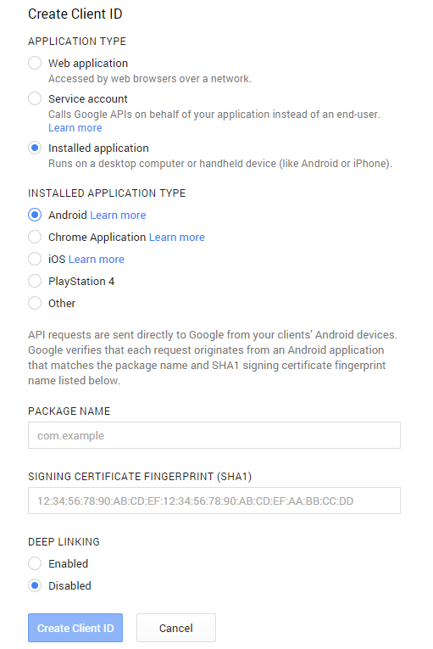
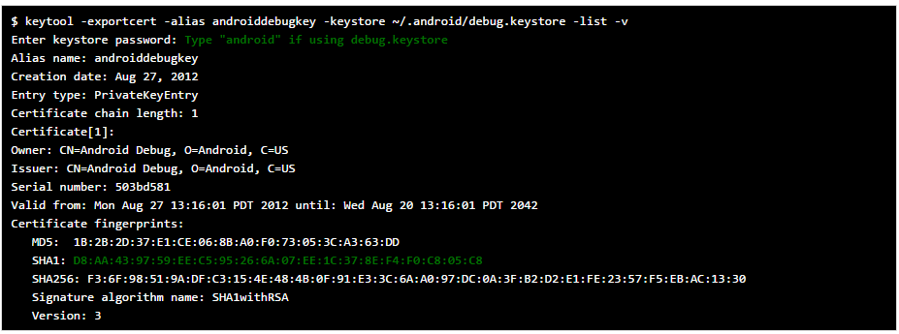
Register app@ Create Credential @ Create Client
Package name of app
SHA1 fingerprint for app signing certificate
SHA1 makes the Google services accessible by app
keytool -exportcert -alias androiddebugkey -keystore path-to-debug-or-production-keystore -list -v
Notes:
Consent:同意

Slide 22
Get user’s Account (Email) with AccountPicker
static final int REQUEST_CODE_PICK_ACCOUNT = 1000;
private void pickUserAccount() {
String[] accountTypes = new String[]{"com.google"}; // list only accounts from the "com.google" domain Intent intent = AccountPicker.newChooseAccountIntent(null, null, accountTypes, false, null, null, null, null); startActivityForResult(intent, REQUEST_CODE_PICK_ACCOUNT); //dialog for the user to pick an account.
}
String mEmail;
protected void onActivityResult(int requestCode, int resultCode, Intent data) {
if (requestCode == REQUEST_CODE_PICK_ACCOUNT) { // Receiving a result from the AccountPicker if (resultCode == RESULT_OK) { mEmail = data.getStringExtra(AccountManager.KEY_ACCOUNT_NAME); // With the account name (email address) acquired, go get the auth token getUsername(); } else if (resultCode == RESULT_CANCELED) { // The account picker dialog closed without selecting an account. // Notify users that they must pick an account to proceed. Toast.makeText(this, R.string.pick_account, Toast.LENGTH_SHORT).show(); } } else if ((requestCode == REQUEST_CODE_RECOVER_FROM_AUTH_ERROR || requestCode == REQUEST_CODE_RECOVER_FROM_PLAY_SERVICES_ERROR) && resultCode == RESULT_OK) { // Receiving a result that follows a GoogleAuthException, try auth again getUsername(); }
}

Slide 23
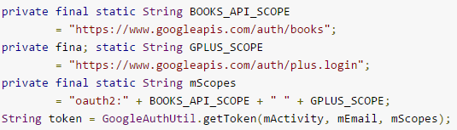
Retrieve the Access Token by using AsyncTask
String mEmail; // get it from AccountPicker
private static final String SCOPE = "oauth2:https://www.googleapis.com/auth/userinfo.profile"; //APIs that app want to access
//start an instance of the AsyncTask to get the auth token and do work with it in worker thread
//because communication to server will possibly consume lots of time to be accomplished
private void getUsername() {
if (mEmail == null) {
pickUserAccount();
} else {
if (isDeviceOnline()) {
new GetUsernameTask(HelloActivity.this, mEmail, SCOPE).execute();
} else {
Toast.makeText(this, R.string.not_online, Toast.LENGTH_LONG).show();
}
}
}
List of valid OAuth scope values for Google services,
refer to https://developers.google.com/oauthplayground/
In case of multiple scopes, using a space to separate each scope

Slide 24
AsyncTask
public class GetUsernameTask extends AsyncTask{ Activity mActivity; String mScope; String mEmail; GetUsernameTask(Activity activity, String name, String scope) { this.mActivity = activity; this.mScope = scope; this.mEmail = name; } protected Void doInBackground(Void... params) { try { String token = fetchToken(); if (token != null) { // Use the token to access the user's Google services. } } catch (IOException e) { ... } return null; } protected String fetchToken() throws IOException { try { return GoogleAuthUtil.getToken(mActivity, mEmail, mScope); } catch (UserRecoverableAuthException userRecoverableException) { mActivity.handleException(userRecoverableException); } catch (GoogleAuthException fatalException) { ... } return null; } ...
}
Perform the time consuming job in worker thread

Slide 25
Deal with the exceptions
public void handleException(final Exception e) { // Because this call comes from the AsyncTask, we must ensure that the following // code instead executes on the UI thread. runOnUiThread (new Runnable() { @Override public void run() { if (e instanceof GooglePlayServicesAvailabilityException) { // The Google Play services APK is old, disabled, or not present. // Show a dialog created by Google Play services that allows the user to update the APK int statusCode = ((GooglePlayServicesAvailabilityException)e).getConnectionStatusCode(); Dialog dialog = GooglePlayServicesUtil.getErrorDialog(statusCode, HelloActivity.this, REQUEST_CODE_RECOVER_FROM_PLAY_SERVICES_ERROR); dialog.show(); } else if (e instanceof UserRecoverableAuthException) { // Unable to authenticate, such as when the user has not yet granted // the app access to the account, but the user can fix this. // Forward the user to an activity in Google Play services to get the token again Intent intent = ((UserRecoverableAuthException)e).getIntent(); startActivityForResult(intent, REQUEST_CODE_RECOVER_FROM_PLAY_SERVICES_ERROR); } } });
}
Back to UI thread for UI manipulation,
because UI thread is NOT thread-safe

Slide 26
Agenda
Overview
Access Google services via Google Play services
Access Google services over HTTP
Example of Google Drive accessing

Slide 27
Creating files by newCreateFileActivityBuilder
public class CreateFileWithCreatorActivity extends BaseDemoActivity {
private static final String TAG = "CreateFileWithCreatorActivity";
protected static final int REQUEST_CODE_CREATOR = 1;
public void onConnected(Bundle connectionHint) {
super.onConnected(connectionHint);
Drive.DriveApi.newDriveContents(getGoogleApiClient()) .setResultCallback(driveContentsCallback);
}
final ResultCallback<DriveContentsResult> driveContentsCallback = new ResultCallback<DriveContentsResult>() {
public void onResult(DriveContentsResult result) {
MetadataChangeSet metadataChangeSet = new MetadataChangeSet.Builder()
.setMimeType("text/html").build(); //MIME of file is text/html
IntentSender intentSender = Drive.DriveApi .newCreateFileActivityBuilder()
.setInitialMetadata(metadataChangeSet) //MIME
.setInitialDriveContents(result.getDriveContents()) //User Inputs
.build(getGoogleApiClient()); //Google API client
try {
//after user specifies the destination folder and title for the file by UI, it will trigger onActivityResult
startIntentSenderForResult( intentSender, REQUEST_CODE_CREATOR, null, 0, 0, 0);
} catch (SendIntentException e) {
Log.w(TAG, "Unable to send intent", e);
}
}
};
}

Slide 28
Files is created
public class CreateFileWithCreatorActivity extends BaseDemoActivity {
private static final String TAG = "CreateFileWithCreatorActivity";
protected static final int REQUEST_CODE_CREATOR = 1;
protected void onActivityResult(int requestCode, int resultCode, Intent data) {
switch (requestCode) {
case REQUEST_CODE_CREATOR:
if (resultCode == RESULT_OK) {
DriveId driveId = (DriveId) data.getParcelableExtra( OpenFileActivityBuilder.EXTRA_RESPONSE_DRIVE_ID);
showMessage("File created with ID: " + driveId);
}
finish();
break;
default:
super.onActivityResult(requestCode, resultCode, data);
break;
}
}
}

Slide 29
Reference
http://developer.android.com/google/index.htm
http://developer.android.com/google/play-services/index.htmll
https://console.developers.google.com/project
https://developers.google.com/drive/

